Slide 1
Travel Tide Analysis
Suna Jayyousi

Slide 2
Introduction
e-booking startup TravelTide is a hot new player in the online travel industry. It has experienced steady growth since it was founded at the tail end of the covid pandemic (2021-04) on the strength of its data aggregation and search technology, which is best in class. Customer feedback has shown, and industry analysts agree, TravelTide customers have access to the largest travel inventory in the e-booking space

Slide 3
Introduction
In this project, we will segment customer data according to business needs and deliver data-driven recommendations based on our findings.

Slide 4
Customer Analysis
To understand customer behavior I made a visualization through tableau
Link

Slide 5
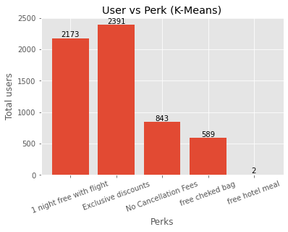
User vs Perk

Slide 6
Recommendations
1-We encourage the marketing department to launch the reward program.
2-focus on exclusive discounts perk.

